Slide 1
eVision Admissions Interfaces
Alastair Baker, Student Systems Programme
18 March 2015
Notes:
I am Alastair Baker and I’m a Business Analyst on the Student Systems Programme (SSP).
The SSP is responsible for delivering the development of Oxford's IT-based systems used by academic and administrative staff, applicants and students in support of many aspects of teaching and learning. We are prioritising the replacement OSS with eVision. In January the on-course student record functionality went live in eVision. We are now working towards the delivery of admissions functionality through eVision.
There is other SSP activity in 2015, but today I will focus on the Admissions project, and particularly on admissions interfaces.

Slide 2
Admissions
Undergraduate and graduate admissions functionality in support of 2015-16 admissions cycle (for entry in 2016-17)
Undergraduate admissions: ADSS and ADMIT remain as main decision making tools for departments and colleges
Graduate admissions: adopt graduate application form which went live in October ’14 and replace OSS Admissions functionality

Slide 3
Admissions scope
Integration with ADSS so that applicant status can be fed back automatically from ADSS into SITS:Vision
Move Open College Allocation Tool from OSS to ADSS
Implement Offer Library in SITS:Vision to simplify process of feeding back to UCAS
Simple, online access to relevant applications
No Coversheets
Application form integrated with rest of SITS:Vision

Slide 4
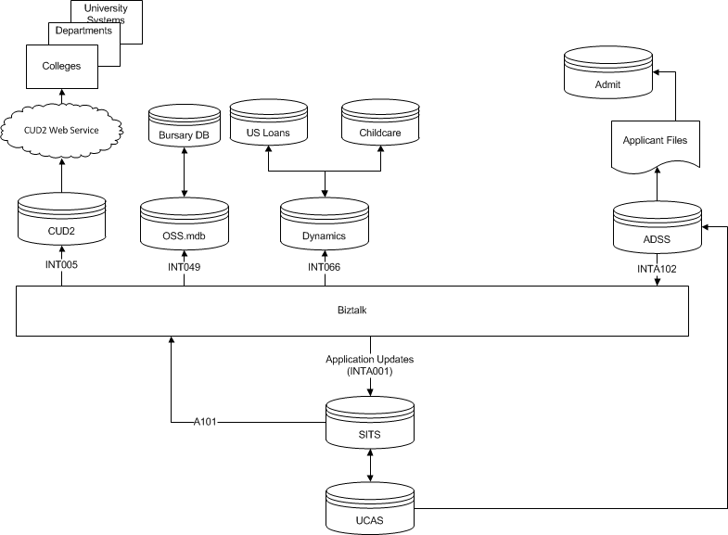
Interfaces - undergraduate
Notes:
UG View of Interfaces
INTA101 – on ramp replaces the existing feed from OSS. Feeds downstream systems – CUD2, OSS.mdb for Bursary, Dynamics for Childcare and US Loans Mostly invisible, but CUD2 will receive co-owning departments and revised applicant statuses.
INTA102/INTA001 – new on and off ramps for passing ADSS updates to SITS. Key update stages: Open College Allocation, Selection/Rejection before interview, Offer/Rejection post-interview.
AdmIT will be supplied from ADSS. Process up to offer performed on ADSS – daily updates to AdmIT

Slide 5
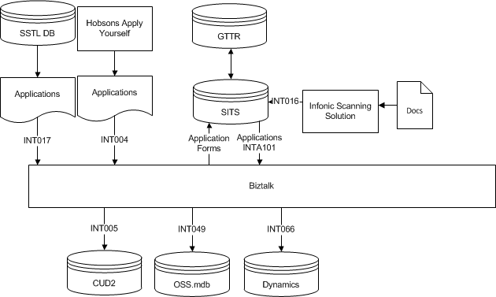
Interfaces - Graduate
Notes:
Graduate Application view
The Applicant interface to CUD2, OSS.mdb and Dynamics are common.
Two file based interfaces for application forms from Software Engineering and SBS.
New mechanism for Graduate Scanned supporting documents

Slide 6
Interfaces
Most interface changes will have no visible effect to end users
Graduate specific interfaces are like-for-like replacements
Business processes for ADSS and ADMIT will change. This will be covered by communications and training
Where changes are required, we will be supporting system owners to make necessary adjustments

Slide 7
Notes:
Question time

Slide 8
Contact details
Student Systems Programme
T: 01865 (2)89975 E: ssp@admin.ox.ac.uk W: www.admin.ox.ac.uk/ac-div/studentsystems/
Student Systems Support Centre
T: 01865 (2)84848 E: student.systems@admin.ox.ac.uk W: www.admin.ox.ac.uk/studentsystems/
Notes:
Both based at Gibson Building

